Slide 1
Resources
De Smedt, B. (2022) Individual Differences in mathematical cognition: a Bert’s eye view. Behavioural Sciences 46, 1 – 10
Supporting children to be active and influential participants in mathematics lessons through effective use of assigning competence and pre-teaching Final Report July 2017, Babcock Partners in Education
Trundley, R. (2018) Changing lives and providing equity through pre-teaching and assigning competence

Slide 2
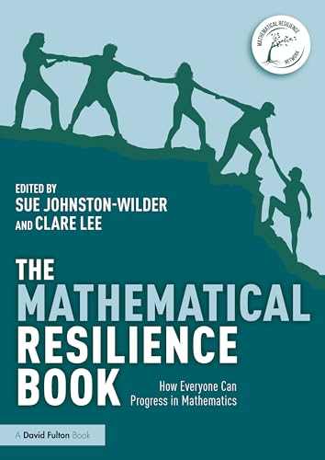
Resilience and Maths Anxiety
Cambridge Espressso: A two-page summary of Maths Anxiety
Video: Really helpful 56-minute video from Dominic Petronzi of the University of Derby. Understanding Maths Anxiety With Dr Dominic Petronzi – YouTube
The Maths Anxiety Trust – Home
Maths Anxiety Research Group
Growth Zone Model – Sue Johnston-Wilder
https://blog.mindresearch.org/blog/math-anxiety
http://www.stevechinn.co.uk/articles/maths-anxiety
Maths-Anxiety-Trust-Teachers-Guide-April-2023.pdf (derby.ac.uk)

